Slide 1

Git and GitHub: Newbie to Intermediate Contributor in 45 Minutes
Tim warner
Techtrainertim.com

Slide 2
Learning goals
Understand Git and GitHub
Introduce the Git/GitHub collaboration workflow
Share Git/GitHub learning resources
Receive your takeaway "marching orders"

Slide 3
Session materials
timw.info/psotr

Slide 4



Understand git and github
asdf

Slide 5
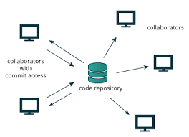

Git
Distributed version control system for (mostly) plain text files
Allows developers to collaborate on software projects
"Track Changes" in Microsoft Word

Slide 6
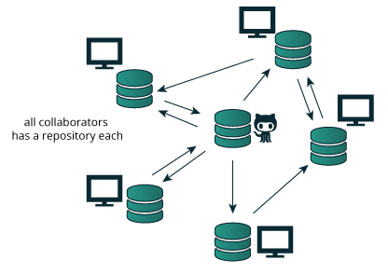
github
Hosted public and private Git repositories
Owned by Microsoft
Visual Studio/VS Code
Azure DevOps
Azure App Services
Azure Data Factory
Etc. etc…

Slide 7
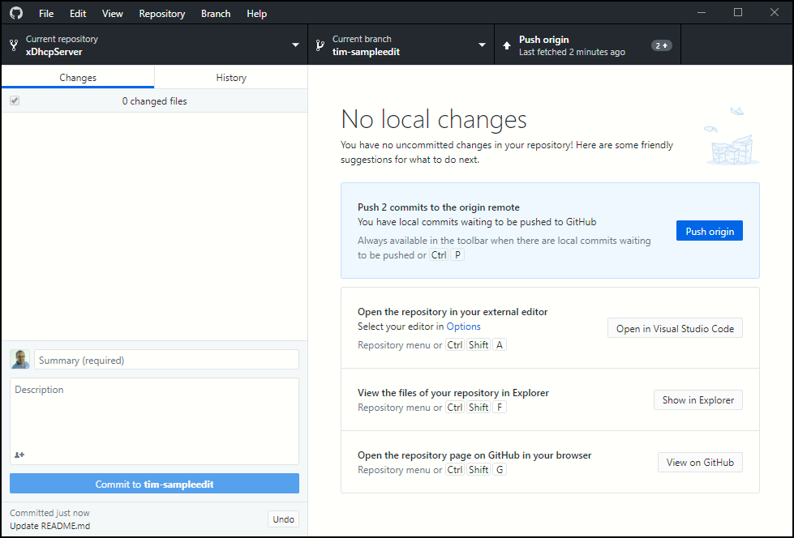
Github desktop
Cross-platform (Electron) desktop application
Abstracts the underlying git commands
Allows you to focus on the workflow more directly

Slide 8

Let's get to work!

Slide 9

Github collaboration workflow

Slide 10
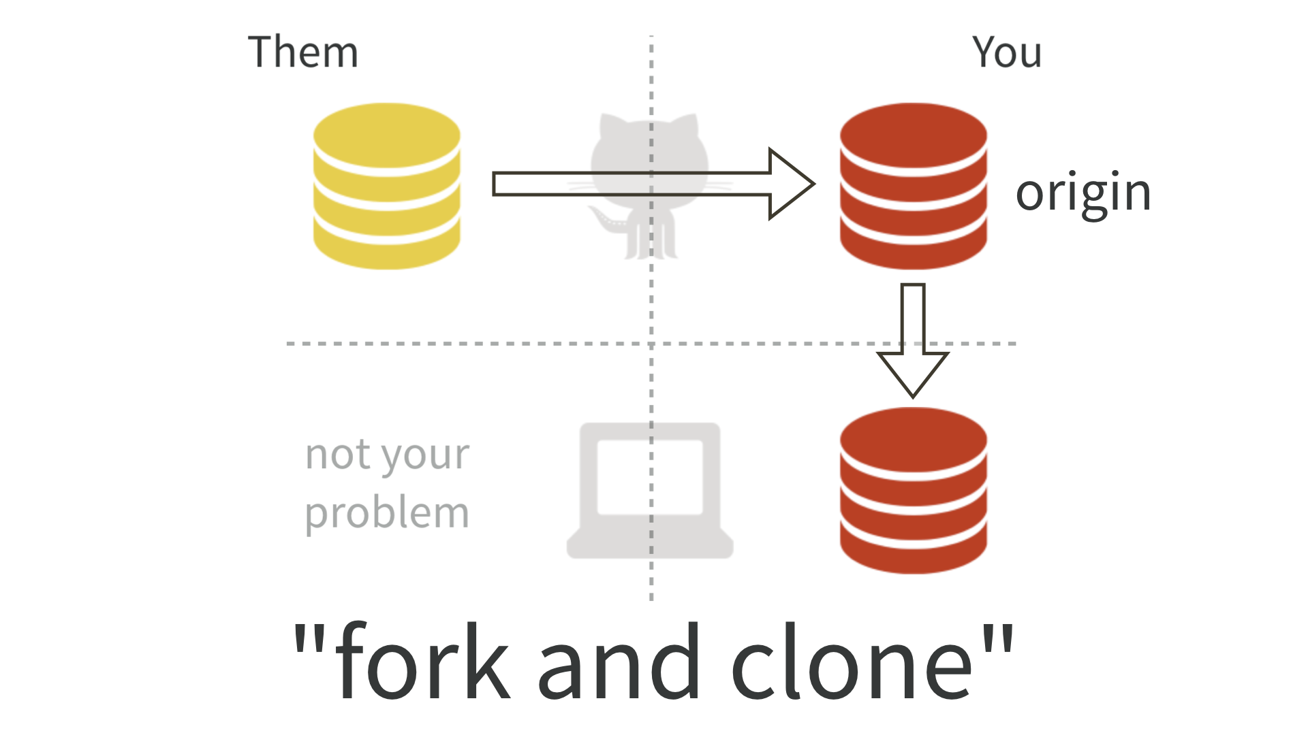
Fork and clone
https://timw.info/3afb2

Slide 11
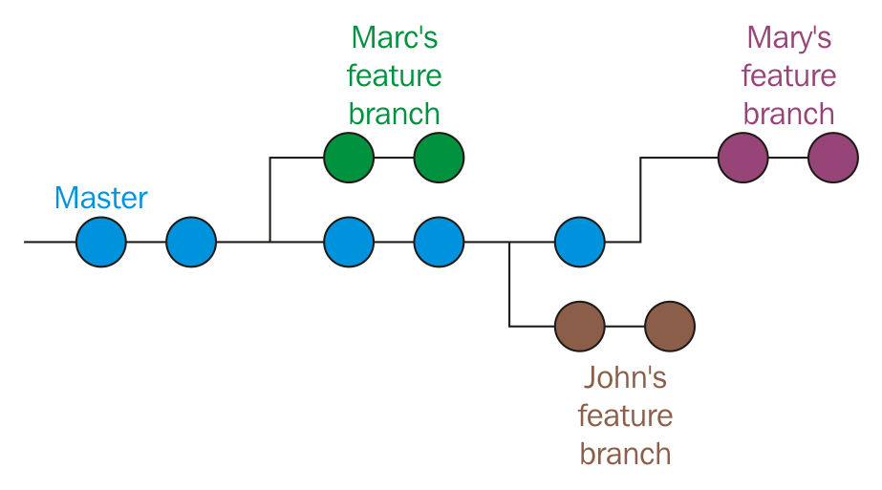
Feature branches
https://timw.info/9a9ae

Slide 12
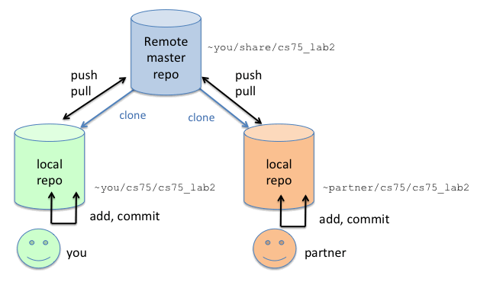
Push changes to remote
https://timw.info/b2ef9

Slide 13
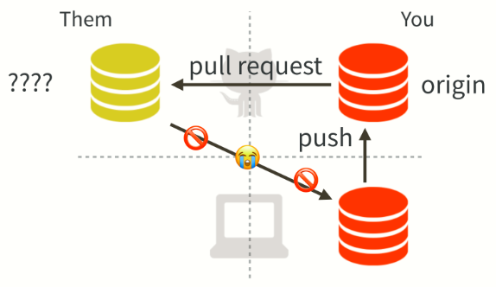

Get (git?) upstream changes
https://timw.info/08531

Slide 14
Sync with upstream
git remote –v
git checkout master
git fetch --all
git rebase upstream/master
git push -u origin master

Slide 15
Let's put all those concepts to use!

Slide 16


Git learning resources

Slide 17

book
https://timw.info/e74d6

Slide 18


video
https://timw.info/7f0d1

Slide 19
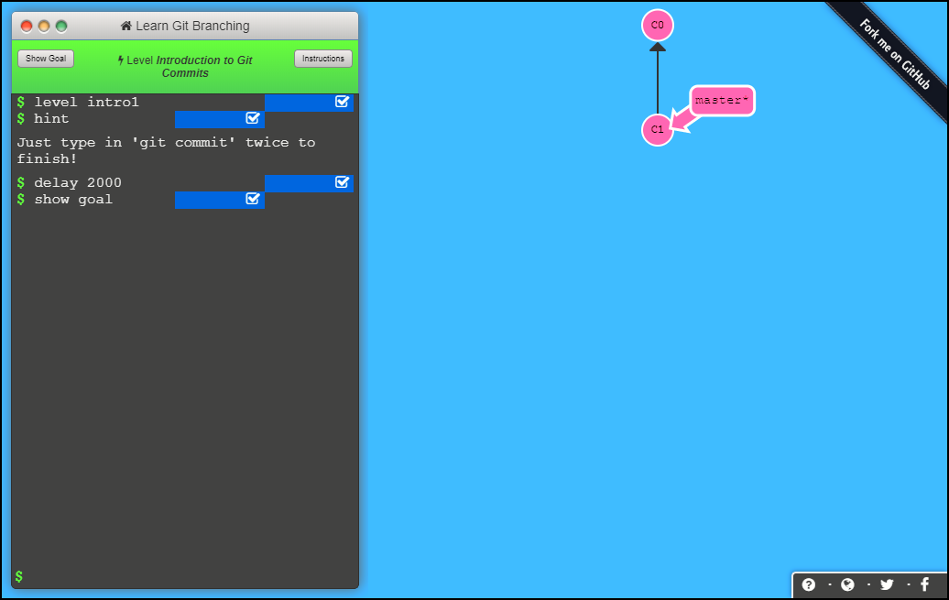
Online tutorial (interactive)
https://learngitbranching.js.org

Slide 20
Your marching orders
Start practicing yourself with a "Hello world" PowerShell project
Contribute to someone's GitHub project
Ask Mike Lombardi (@TrebuchetOps) for help

Slide 21
Thank you!
Session materials: timw.info/psotr
Personal website: timw.info
Pluralsight courses: timw.info/ps

